Slide 1
Exploring Youth Drug Use: Best Predictors and Differences between Substances
Tyler Franck

Slide 2
Outline
Introduction
Theoretical Background
Decision Trees
Bagging
Random Forests
Boosting
Methodology
Results
Alcohol (Binary)
Marijuana (Multi-class)
Cigarette (Regression)
Conclusion

Slide 3
Introduction
Explore youth drug use using a filtered version of the 2023 National Survey on Drug Use and Health
The data includes:
For alcohol, marijuana, and cigarettes:
frequency of use over the last year/month
age of first use
have/have not used ever
imputed categories for drug frequency (e.g. 1-2 days, 3-5 days, 6-10 days)
Basic demographics like sex, race, household income
Youth-specific questions like parental presence in the household and school attendance
Going to use tree-based methods (decision tree, bagging, random forests, and boosting) to try to answer the following question: Which demographic, behavioral, and social factors best predict ongoing drug usage, and do these predictors differ for alcohol, marijuana, and cigarettes?
We will use substance usage in the past month to measure “ongoing” drug usage
Notes:
Explored youth drug use using the 2023 NSDUH dataset, which includes usage statistics for alcohol, marijuana, and cigarettes, demographics, and youth-specific questions

Slide 4
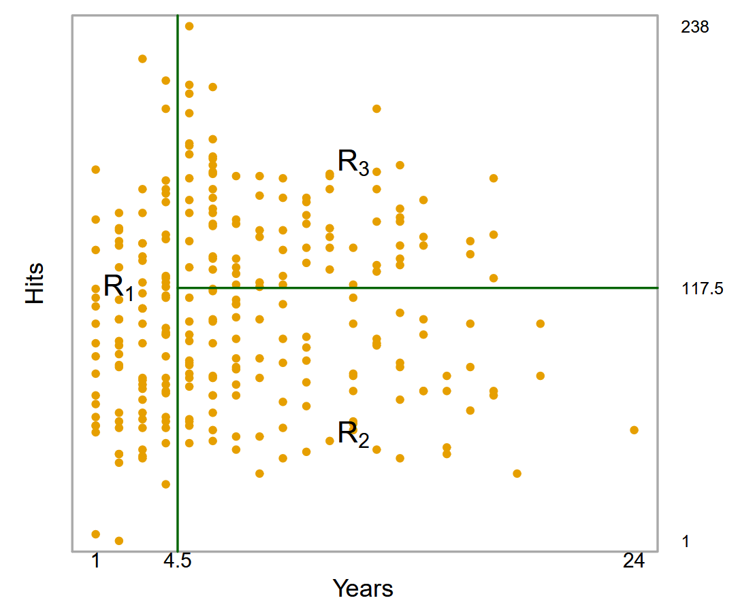
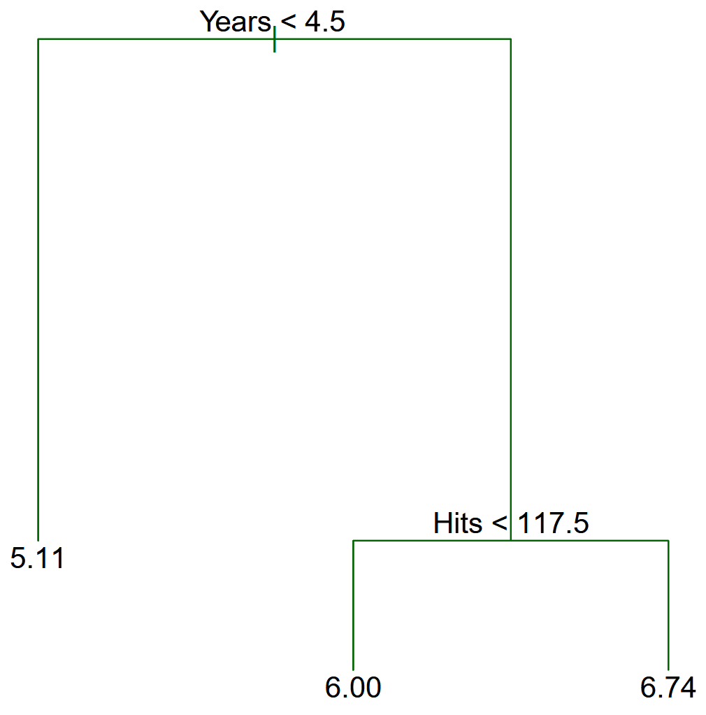
Theoretical Background (Decision Trees)
Decision trees work by partitioning the predictor space into simple, rectangular regions and making predictions using some aggregate of the training observations in the corresponding region
They are called decision tree methods because the splitting rules can be represented with a tree structure
Notes:
Decision trees split the predictor space into rectangles and just predict some aggregate of the training observations in the rectangles (mean for regression, mode for classification)
For example, we would predict the mean of the observations in R1

Slide 5
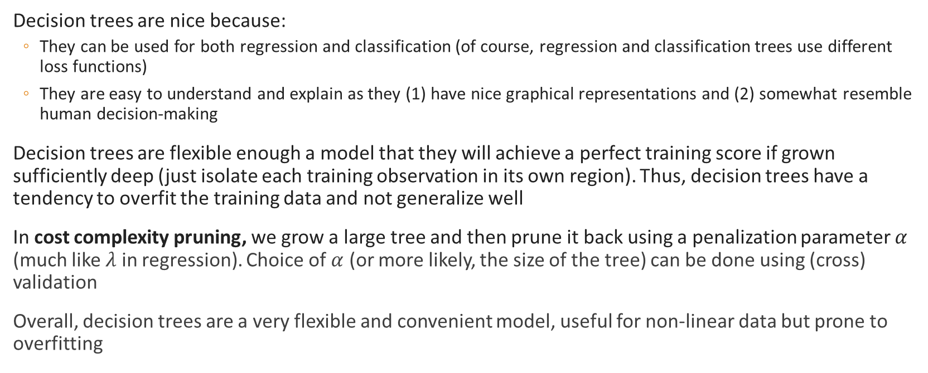
Theoretical Background (Decision Trees)
Decision trees are nice because:
They can be used for both regression and classification (of course, regression and classification trees use different loss functions)
They are easy to understand and explain as they (1) have nice graphical representations and (2) somewhat resemble human decision-making
Decision trees are flexible enough a model that they will achieve a perfect training score if grown sufficiently deep (just isolate each training observation in its own region). Thus, decision trees have a tendency to overfit the training data and not generalize well
In cost complexity pruning, we grow a large tree and then prune it back using a penalization parameter $α$ (much like $λ$ in regression). Choice of $α$ (or more likely, the size of the tree) can be done using (cross) validation
Overall, decision trees are a very flexible and convenient model, useful for non-linear data but prone to overfitting
Notes:
Decision trees are convenient because they work for both regression and classification (and you don’t have to one-hot-encode!) and they are easy to understand and explain. The downside is that they are very flexible and tend to overfit the training data.
To combat this, we use cost complexity pruning to prune back complicated trees via penalization, kind of like regularization in ridge regression

Slide 6
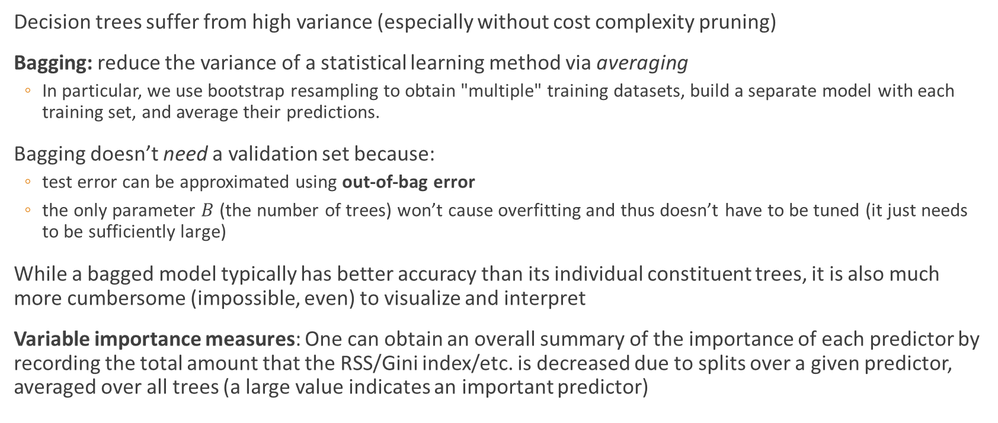
Theoretical Background (Bagging)
Decision trees suffer from high variance (especially without cost complexity pruning)
Bagging: reduce the variance of a statistical learning method via averaging
In particular, we use bootstrap resampling to obtain "multiple" training datasets, build a separate model with each training set, and average their predictions.
Bagging doesn’t need a validation set because:
test error can be approximated using out-of-bag error
the only parameter $B$ (the number of trees) won’t cause overfitting and thus doesn’t have to be tuned (it just needs to be sufficiently large)
While a bagged model typically has better accuracy than its individual constituent trees, it is also much more cumbersome (impossible, even) to visualize and interpret
Variable importance measures: One can obtain an overall summary of the importance of each predictor by recording the total amount that the RSS/Gini index/etc. is decreased due to splits over a given predictor, averaged over all trees (a large value indicates an important predictor)
Notes:
Bagging is a general strategy that reduces variance by averaging many models together: we use bootstrap resampling to obtain multiple training sets, train models on the training sets, and then average their predictions. Unfortunately, this boost in performance comes at the cost of interpretability (it’s hard to interpret the aggregate of hundreds of trees).
Luckily, we can use variable importance measures to see which predicts are the most important. These work by basically looking at how much splitting on that variable improves metrics.

Slide 7
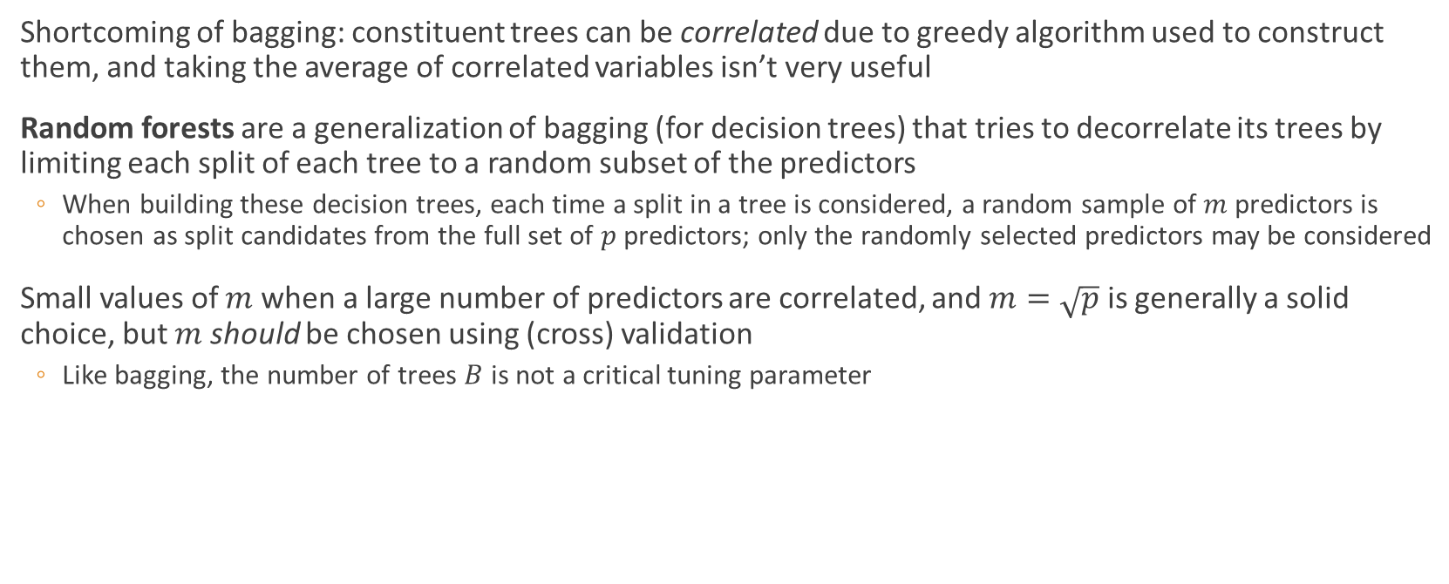
Theoretical Background (Random Forest)
Shortcoming of bagging: constituent trees can be correlated due to greedy algorithm used to construct them, and taking the average of correlated variables isn’t very useful
Random forests are a generalization of bagging (for decision trees) that tries to decorrelate its trees by limiting each split of each tree to a random subset of the predictors
When building these decision trees, each time a split in a tree is considered, a random sample of $m$ predictors is chosen as split candidates from the full set of $p$ predictors; only the randomly selected predictors may be considered
Small values of $m$ when a large number of predictors are correlated, and $m=\sqrt{p}$ is generally a solid choice, but $m$ should be chosen using (cross) validation
Like bagging, the number of trees $B$ is not a critical tuning parameter
Notes:
On problem with bagging is that its constituent trees can be correlated. For example, if one predictor is much better than the others, than all trees will start with that predictor due to the greedy algorithm used to construct them. This is problematic because taking the average of correlated variables isn’t very useful (you want their errors to cancel each other out).
Random forests fix this by randomly choosing which predictors can be considered at each split. m – the number of predictors considered at each split – is a parameter that must be chosen with a validation approach.

Slide 8
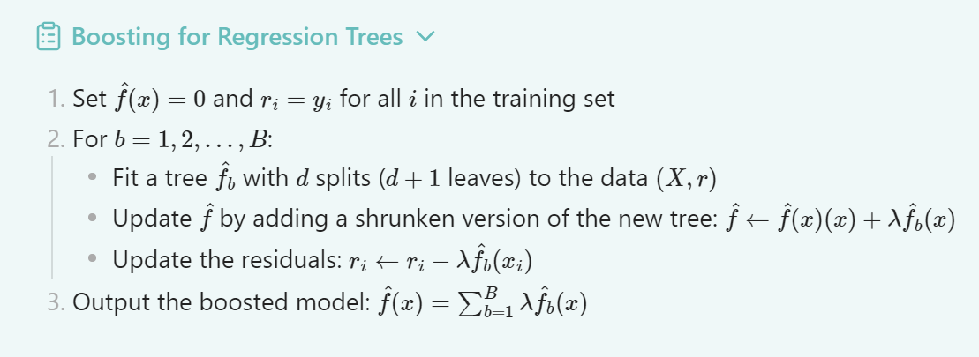
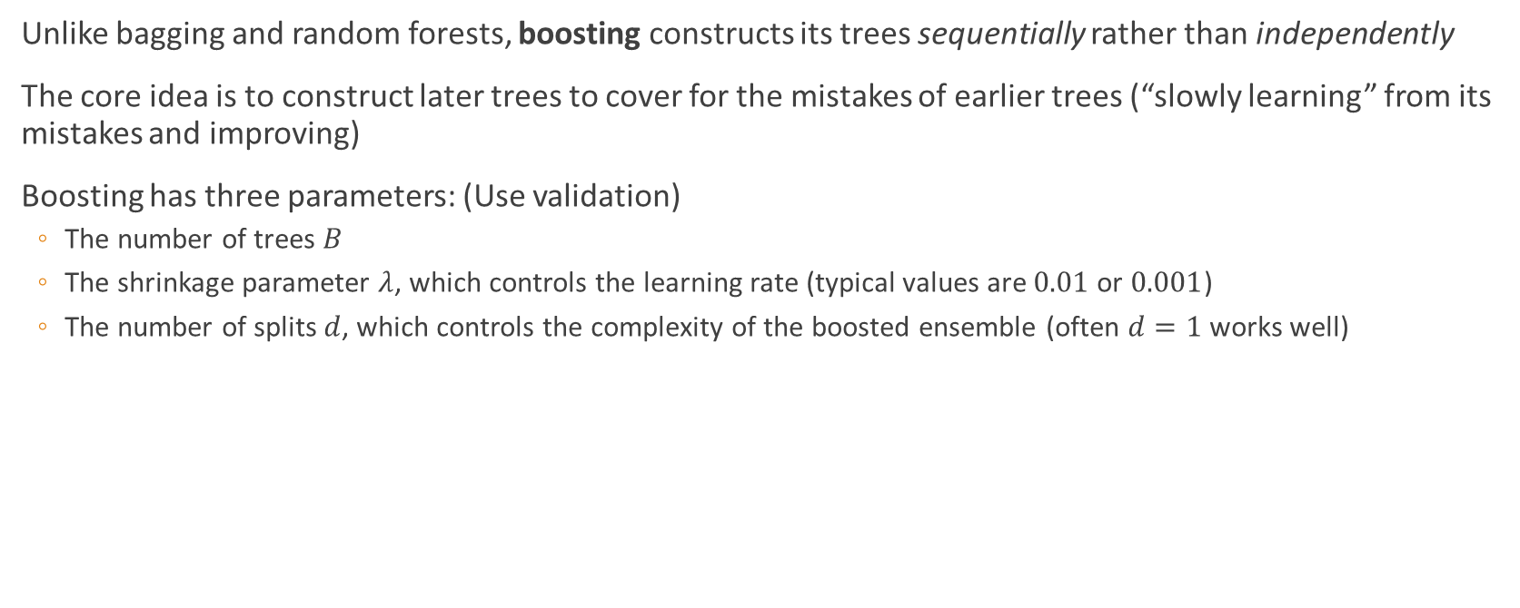
Theoretical Background (Boosting)
Unlike bagging and random forests, boosting constructs its trees sequentially rather than independently
The core idea is to construct later trees to cover for the mistakes of earlier trees (“slowly learning” from its mistakes and improving)
Boosting has three parameters: (Use validation)
The number of trees $B$
The shrinkage parameter $λ$, which controls the learning rate (typical values are $0.01$ or $0.001$)
The number of splits $d$, which controls the complexity of the boosted ensemble (often $d=1$ works well)
Notes:
Boosting takes a different approach than bagging and random forests: Instead of constructing its trees independently and then averaging, it builds its trees sequentially and each trees contribution is weighted. The core idea is to grow new trees to learn from past mistakes.

Slide 9
Methodology
Three sections of analysis: alcohol (binary), marijuana (multi-class), and cigarette (regression)
For each substance, we:
Compute response variable and drop “equivalent” predictors
Split dataset into training (75%) and test (25%) sets
Fit a decision tree (prune it if too complex)
Fit an ensemble method (use test set to a validation set for parameter tuning)
Evaluate model performance and assess variable importance
Notes:
Okay, we have three sections of analysis: one for alcohol, marijuana, and cigarette. The binary/multi-class/regression refers to the type of response variable we will be trying to predict.
Our general approach is to:
- Compute the response variable and drop “equivalent” predictors (e.g., don’t try to predict binary usage with the number of times they’ve used it). Sometimes this involves reordering categories (e.g., 1=low,…,4=high,5=none >>> 0=none).
- Split the dataset into a training and test set; we use a 75/25 split
- For each substance we try a decision tree and one of the ensemble methods, which can involve pruning (for the decision tree) and hyperparameter search (for the ensemble method)
- Lastly, if model isn’t completely worthless, we try to assess which predictors are the most important (look at decision tree, variable importance plot, relative influence)

Slide 10
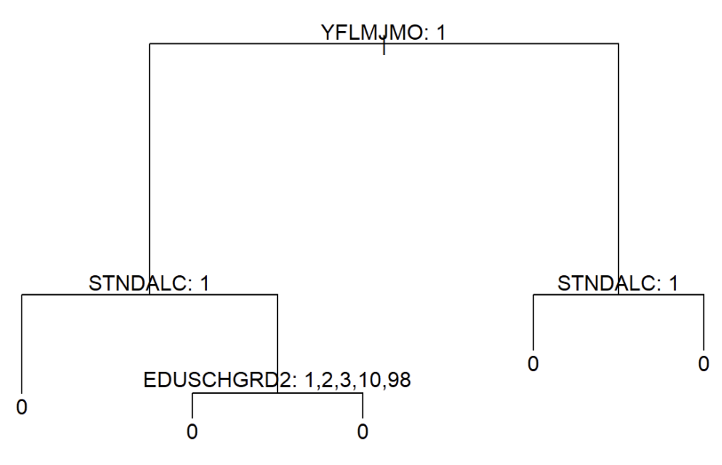
Results: Alcohol (Decision Tree)
Decision tree just predicts the most common response (no alcohol), and so we can’t say anything about predictor importance
Notes:
There is a variable in the dataset (IRALCFM) that indicates frequency of alcohol consumption in past month. We created a binary variable indicating whether they used alcohol in the last month by checking whether $\text{IRALCFM}\text{<91}$ (>=91 meant didn’t use/never used).
The decision tree ended up just predicting the most common response (no alcohol), which isn’t very useful. You can see here every branch leads to 0 (didn’t rename because it literally doesn’t matter). Since the model isn’t even using the predictors, we can’t say anything about predictor importance.

Slide 11
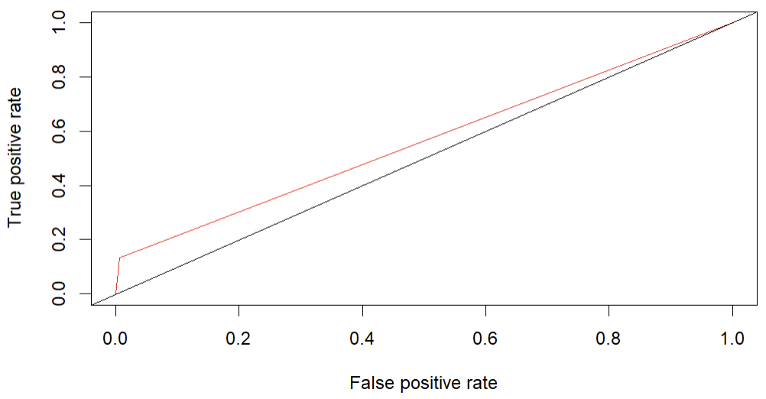
Results: Alcohol (Bagging)
Balanced accuracy: 0.5636
Notes:
Balanced accuracy and ROC curve show that the model capturing something more than just the most common response. Correctly identified a non-drinker 99.3% of the time (sensitivity); and correctly identified a drinker 13.4% of the time (specificity).
This means that it is actually insightful to look at what predictors it thinks is important.

Slide 12
Results: Alcohol (Bagging)
Predictor | Mean Decrease in Accuracy | Mean Decrease in Gini
YFLMJMO | 33.67 | 44.14
STNDALC | 23.51 | 39.74
INCOME | 25.47 | 39.49
YFLMJMO: How youth feels about peer marijuana usage
STNDALC: How much other students drink alcohol
INCOME: Family income
Notes:
Very few above 20 MDA, Very few above 30 MDG. Tried to choose predictors that were highly rated in both.

Slide 13
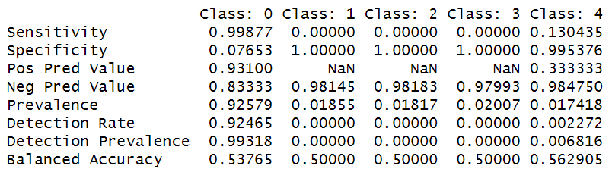
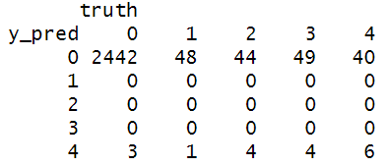
Results: Marijuana (Decision Tree)
Nontrivial balanced accuracies for the lowest and highest frequencies of usage:
Notes:
There is a variable (MRJMDAYS) that indicates marijuana frequency in last month (1=1-2, 2=3-5, 3=6-19, 4=20-30, 5=none). I changed the «none» value so that the ordering made sense (5=none > 0=none).
Again, we see that it is doing better than just guessing the most common response, and so we’re interested in how it’s using the predictors.

Slide 14
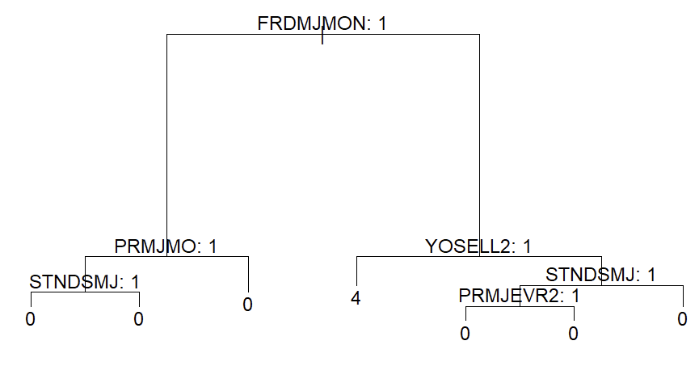
Results: Marijuana (Decision Tree)
Notes:
This was the original decision tree – you can see it’s kind of a mess (different branches all predicting 0). So we pruned it!

Slide 15
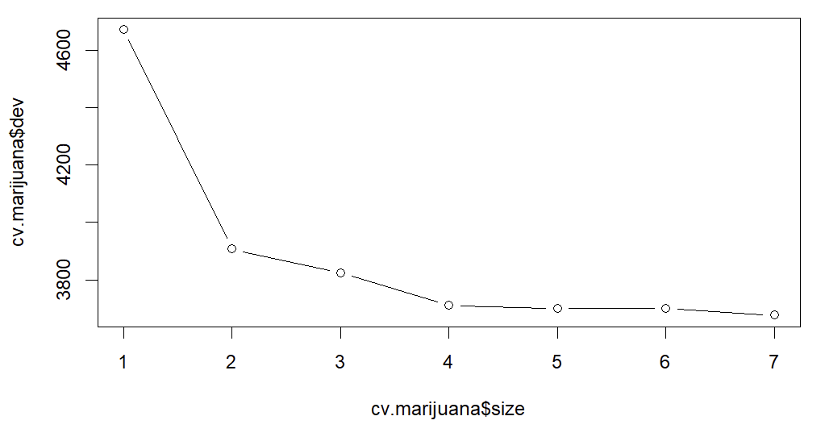
Results: Marijuana (Decision Tree)
Notes:
This is the plot of deviance by size. Size = 2 and size = 3 looked good; I went with size = 3.

Slide 16
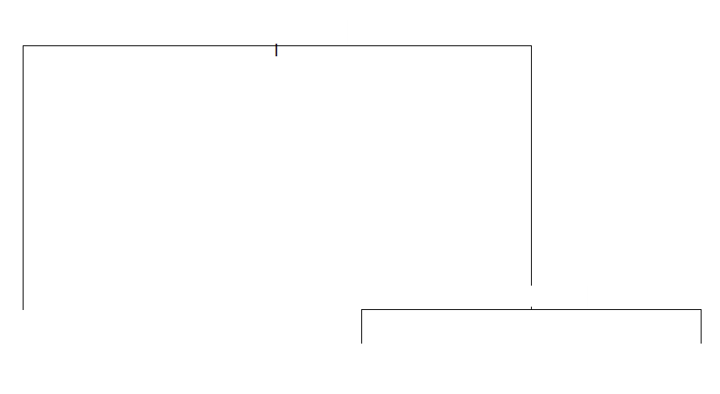
Results: Marijuana (Decision Tree)
How close friends feel about youth using marijuana
Disapprove
Don’t disapprove
Youth has sold illegal drugs
0
Yes
No
20-30
0
Notes:
And this gives us a simpler tree. It’s actually equivalent to the previous one, just simplified. We can see that…

Slide 17
Results: Marijuana (Decision Tree)
FRDMJMON: How close friends feel about youth using marijuana
YOSELL2: Whether youth has sold illegal drugs

Slide 18
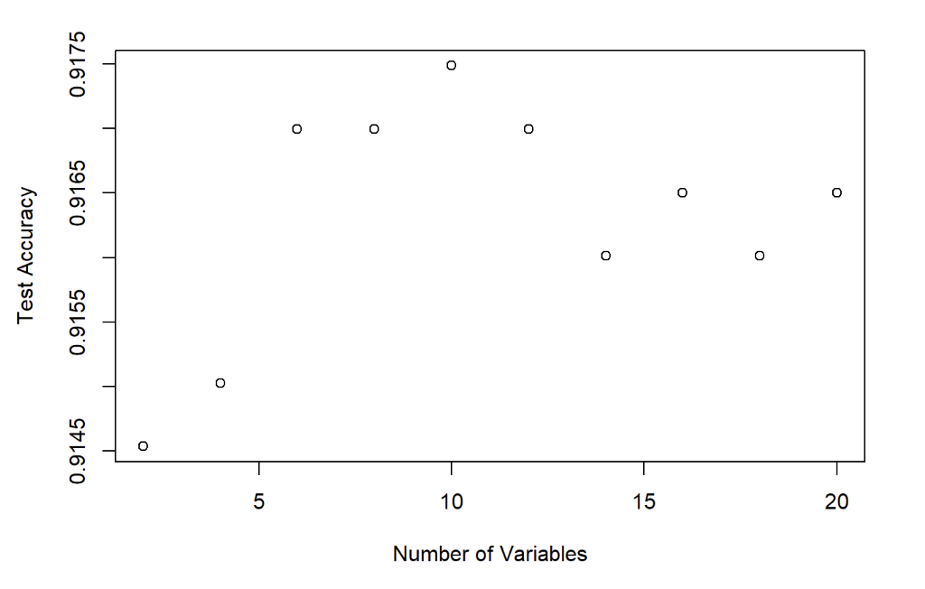

Results: Marijuana (Random Forest)
Used validation scores to tune $m$ (tried values up to $p/3$)
Notes:
Remember that for random forests we have to choose the parameter m, which is the number of predictors to consider at each split. This is the plot of test accuracy by number of variables (up to 1/3 of the predictors). The accuracy rises and then dips back down; m=10 seemed like a good choice.

Slide 19
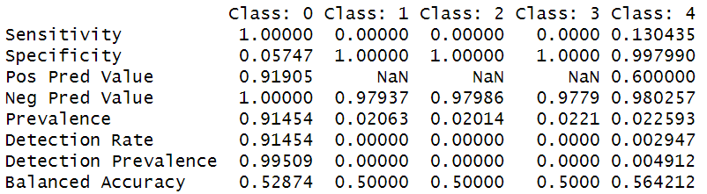
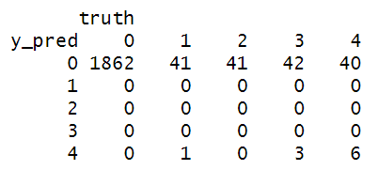
Results: Marijuana (Random Forest)
Nontrivial balanced accuracies for the lowest and highest frequencies of usage:
Notes:
Like with the decision tree… it seems to actually be using the predictors and doing better than the null model

Slide 20
Results: Marijuana (Random Forest)
Predictor | Mean Decrease in Accuracy | Mean Decrease in Gini
YOSELL2 | 19.55 | 21.82
PRMJMO | 9.79 | 24.56
INCOME | 7.98 | 27.38
YFLTMRJ2 | 9.80 | 18.22
YOSELL2: Whether youth has sold illegal drugs
PRMJMO: How (youth thinks) parents would feel about them using marijuana (monthly)
INCOME: Family income
YFLTMRJ2: How youth feels about peers trying marijuana
Notes:
10 good MDA, 20 good MDG

Slide 21
Results: Cigarette (Decision Tree)
Compared the decision tree against the base-line null model (we just guess the mean value):
Base-line MSE: 0.278
Model MSE: 0.353
Since the model doesn’t even outperform a model that doesn’t use any of the predictors, we can’t really conclude anything about predictor performance.
Notes:
There is a variable (IRCIGFM ) that gives the number of days they used cigarettes in past month. We just changed the none values (91 or something) to 0.
You see that the trained decision tree actually did WORSE than just guessing the mean value. This might suggest overfitting, and I would have liked to try pruning the tree but it wouldn’t actually get smaller when I set a smaller size; it just didn’t seem to be working.

Slide 22
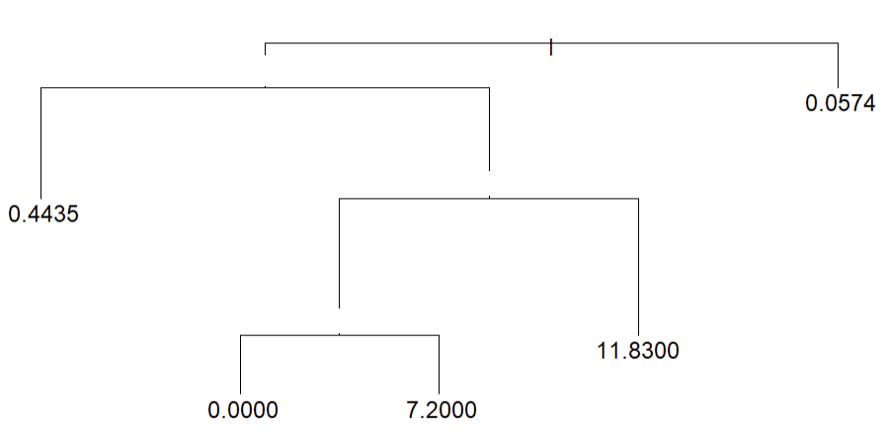
Results: Cigarette (Decision Tree)
Youth stole/tried to steal item >$50
Current Grade
Yes
No
6-11, College 1st year, “legitimate skip”
How youth feels about peers smoking a pack a day
Disapprove
How youth feels about friends drinking daily
Disapprove
Notes:
Here’s the tree. You can see that it’s kind of all over the place, which is in-line with it overfitting (for example… look at current grade).

Slide 23
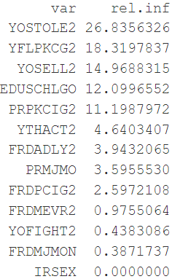

Cigarette (Boosting)
Performed grid search (using test set to validate) over:
$B∈\left\{100, 500, 1000\right\}$
$d∈\left\{1, 2\right\}$
$λ∈\left\{0.1, 0.01, 0.001\right\}$
Results were minimal:
Base-line MSE: 0.278
Model MSE: 0.277
Percent of data explained: 0.64%
Notes:
For boosting, we did a 3-dimensional grid search over B (the number of trees), d (the interaction depth), and lambda (the learning rate). The best model just BARELY did better than the null model, which is kind of disappointing but we can still look at the variable relative influences.

Slide 24
Cigarette (Boosting)
YOSTOLE2: Youth stole or tried to steal and item more expensive than $50
YFLPKCG2: How youth feels about peers smoking
YOSELL2: Has youth sold illegal drugs
EDUSCHLGO: Is the youth going to school
PRPKCIG2: How youth thinks parents would feel about them smoking 1+ pack a day

Slide 25
Conclusion
Question: Which demographic, behavioral, and social factors best predict ongoing drug usage, and do these predictors differ for alcohol, marijuana, and cigarettes?
Alcohol:
YFLMJMO: How youth feels about peer marijuana usage
STNDALC: How much other students drink alcohol
INCOME: Family income
Marijuana:
FRDMJMON: How close friends feel about youth using marijuana
YOSELL2: Whether youth has sold illegal drugs
PRMJMO: How (youth thinks) parents would feel about them using marijuana (monthly)
INCOME: Family income
YFLTMRJ2: How youth feels about peers trying marijuana
Cigarette:
YOSTOLE2: Youth stole or tried to steal and item more expensive than $50
YFLPKCG2: How youth feels about peers smoking
YOSELL2: Has youth sold illegal drugs
EDUSCHLGO: Is the youth going to school
PRPKCIG2: How youth thinks parents would feel about them smoking 1+ pack a day
Notes:
So, our original question was: Which demographic, behavioral, and social factors best predict ongoing drug usage, and do these predictors differ for alcohol, marijuana, and cigarettes?
There’s a lot of similarities between the three substances. In particular, they all seem to be well-predicted by social influence social influence: friend/peer/parent attitude towards the substance. 2/3 of them also included family income, which was the only demographic that seemed relevant.
On the other hand, we saw that alcohol was unique in that it wasn’t predicted by deviant behavior (selling drugs, stealing), and it was predicted by OTHER substance use. Alcohol’s best predicters were purely social and demographic, whereas marijuana and cigarettes included a lot more behavioral predictors (especially, crime-related ones). This kind of makes sense as alcohol is a lot more “casual” than marijuana and cigarettes (in the sense that people are less likely to raise a fuss about it).
The granularity of response variable (binary, multi-class, regression) didn’t seem to matter (the models were all equally mediocre), though we didn’t really have a good basis of comparison.
One takeaway from all of this is that prevention strategies should focus on social environments rather than just individual education (it’s not enough to say drugs bad). We have to do it in a way that avoid stigmatization people aren’t really receptive to perceived attacks/insulted/judgement from above. You have to be empathetic, genuinely try to understand their situation and help them, not deliver top-down commands (that might only fuel a rebellious streak, and it’s also just not kind).

Slide 26
Conclusions
Alcohol binary classification was mostly a wash, perhaps identifying a correlation with peer alcohol consumption, family income, and thoughts about marijuana
Marijuana multi-class classification was stronger, perhaps identifying a correlation with whether youth has sold illegal drugs, family income, father availability in the household, and how youth thinks their parents would feel them using marijuana
Cigarette regression was the strongest, identifying a correlation with whether youth stole or tried to steal and item more expensive than $50, whether youth sold illegal drugs, their current grade, how youth feels about peers smoking/drinking, and how youth thinks their parents would feel about them smoking 1+ pack a day
Throughline: Other substance usage/interaction, peer usage, parental attitude towards substance usage, and perhaps family income

